Slide 1

Anomaly Detection Challenge -4
Spam Filtering
“The Outliers” presents
Nithish Raghunandanan
Vishal Bhalla
Picture courtesy Volusion

Slide 2
Agenda
Introduction
System Pipeline
Data Preprocessing & Analysis
Feature Engineering
Model - Tuning & Evaluation
Kaggle Results
Conclusion
Key Takeaways
The Outliers - Vishal Bhalla & Nithish Raghunandanan

Slide 3
Introduction
Aim: Classify mail into spam (0) or ham (1).
Problem Type: Binary Classification
Samples
  Training Set: 2500
  Test Set: 1827
Features: Emails in RFC822 format.
Classification
  There are 2 decision classes: 0(Spam) and 1(Ham).
The Outliers - Vishal Bhalla & Nithish Raghunandanan

Slide 4
System Pipeline
Data Visualization
Feature Selection
Evaluation of Models
Data Visualization
  Tabulate & analyse the structure of the data.
Feature Selection
  Encoding selected parts of the data as features.
Evaluation of Models
  Classification accuracy using K Fold Stratified Cross Validation.
The Outliers - Vishal Bhalla & Nithish Raghunandanan

Slide 5
Data Preprocessing
Removal of Missing Training Samples
  No Static Analysis and Anti Virus Signatures for 429 samples of the training set
  Removed the training samples from the training phase
The Outliers - Vishal Bhalla & Nithish Raghunandanan

Slide 6
Data Analysis
PE Info
  Multiple pe_section, pe_resources, pe_import, pe_timestamp, rich_header sections per sample.
    Sample File
  Analysis of Sections
    Analysis
VT Info
  Single Signature for some of the 75 Anti Viruses per sample.
    Sample File
  Frequency Analysis for Anti Virus Signatures.
    Analysis
The Outliers - Vishal Bhalla & Nithish Raghunandanan

Slide 7
Feature Engineering
  VT Info
    Selecting sub set of Anti Viruses with high variance.
    Selecting all Anti Viruses.
    Reduction of Null Feature Vectors.
  Variance of Anti Virus
    Variance = Total No. of Samples / No. of Unique Signatures
The Outliers - Vishal Bhalla & Nithish Raghunandanan

Slide 8
Feature Engineering(2)
  Encoding of Features
    One Hot Encoding
      Blow up of features.
      75 anti viruses * 203 Signatures on average
    Binary Encoding
      Presence/Absence of Anti virus signature for the sample
    Frequency Encoding
      Variance of Anti virus/ Total Occurences for the Signature
The Outliers - Vishal Bhalla & Nithish Raghunandanan

Slide 9
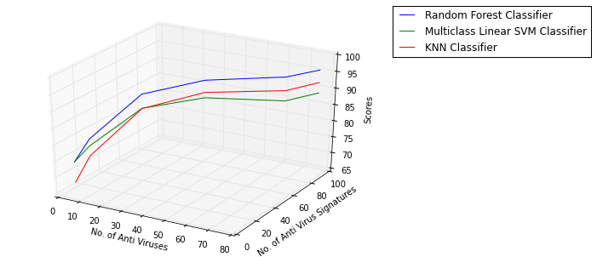
Feature Engineering(3)
Analysis of Number & Signature of Anti Viruses
The Outliers - Vishal Bhalla & Nithish Raghunandanan

Slide 10
Feature Engineering(4)
  PE Info
    Most of the sections are repeated per sample.
    Mean, Median & Mode could be tried on Numerical Features.
    Entropy Mean & Median gave best results.
    Increasing number of features did not necessarily give better results compared to pure VT Info Encoding.
    Selected just Entropy.
The Outliers - Vishal Bhalla & Nithish Raghunandanan

Slide 11
Model
We tried different types of Multi Class Classification Models to fit our data
  Random Forests
  Multi Class SVM with Linear Kernel
  K Nearest Neighbors with 3 Neighbors
The Outliers - Vishal Bhalla & Nithish Raghunandanan

Slide 12
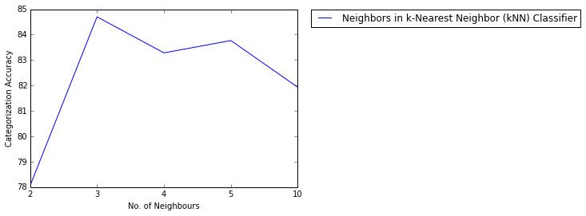
Tuning Model Parameters
K Nearest Neighbors (kNN)
The Outliers - Vishal Bhalla & Nithish Raghunandanan

Slide 13
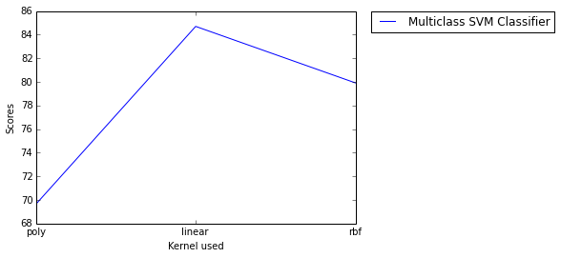
Tuning Model Parameters(2)
Multi Class Support Vector Machines (SVM)
The Outliers - Vishal Bhalla & Nithish Raghunandanan

Slide 14
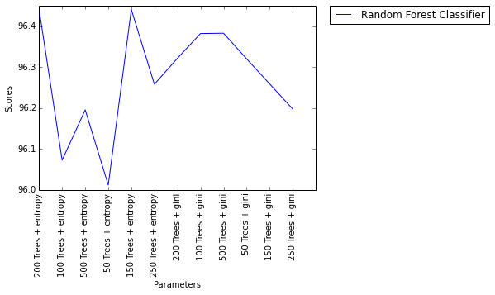
Tuning Model Parameters(3)
Random Forests (RF)
The Outliers - Vishal Bhalla & Nithish Raghunandanan

Slide 15
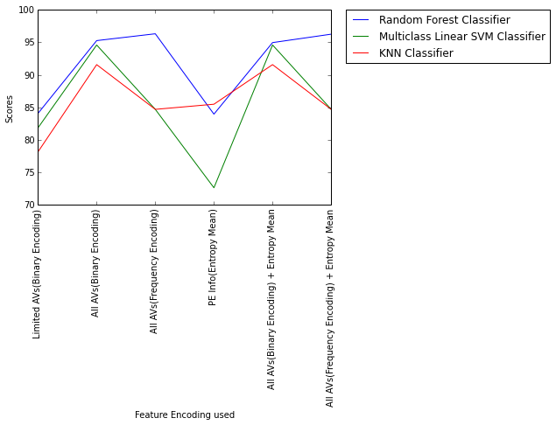
Evaluation of the Models
Criteria
Classification Accuracy on Stratified K-Fold Cross Validation with a split of 4:1.
The Outliers - Vishal Bhalla & Nithish Raghunandanan

Slide 16
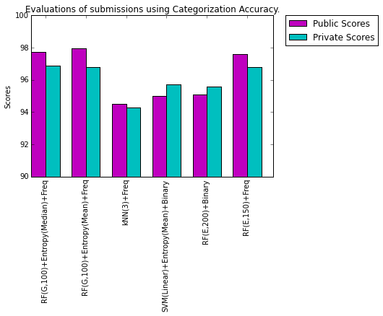
Kaggle Results
The Outliers - Vishal Bhalla & Nithish Raghunandanan

Slide 17
Conclusion
The best results were observed for Random Forest (100 trees with Gini as a criterion) on Frequency Encoded all Anti Viruses' VT Info data.
The addition of Entropy Mean/Median from PE Info gives almost the same result as pure Frequency based VT Info encoding on all Anti Viruses.
KNN & Multi Class SVM worked better on Binary Encoding of VT Info.
The Outliers - Vishal Bhalla & Nithish Raghunandanan

Slide 18
Key Takeaways
Visualization for analysis of data set for feature engineering.
Inherent structure of our data consisted of mainly categorical features. Random Forest Classifier works well on categorical features.
Adding more features could result in overfitting.
The Outliers - Vishal Bhalla & Nithish Raghunandanan

Slide 19

Questions?
The Outliers - Vishal Bhalla & Nithish Raghunandanan

Slide 20
Thank You !
The Outliers - Vishal Bhalla & Nithish Raghunandanan

